Slide 1
Intro To Value Sensitive Design
Khoury College of Computer Sciences
Northeastern University
John Basl, Ron Sandler, Christo Wilson
Edited 10/21/19

Slide 2
Values and Technology
Technology is the result of human imagination
All technology involves design
All design involves choices among possible options
All choices reflects values
Therefore, all technologies reflect and affect human values
Ignoring values in the design process is irresponsible

Slide 3
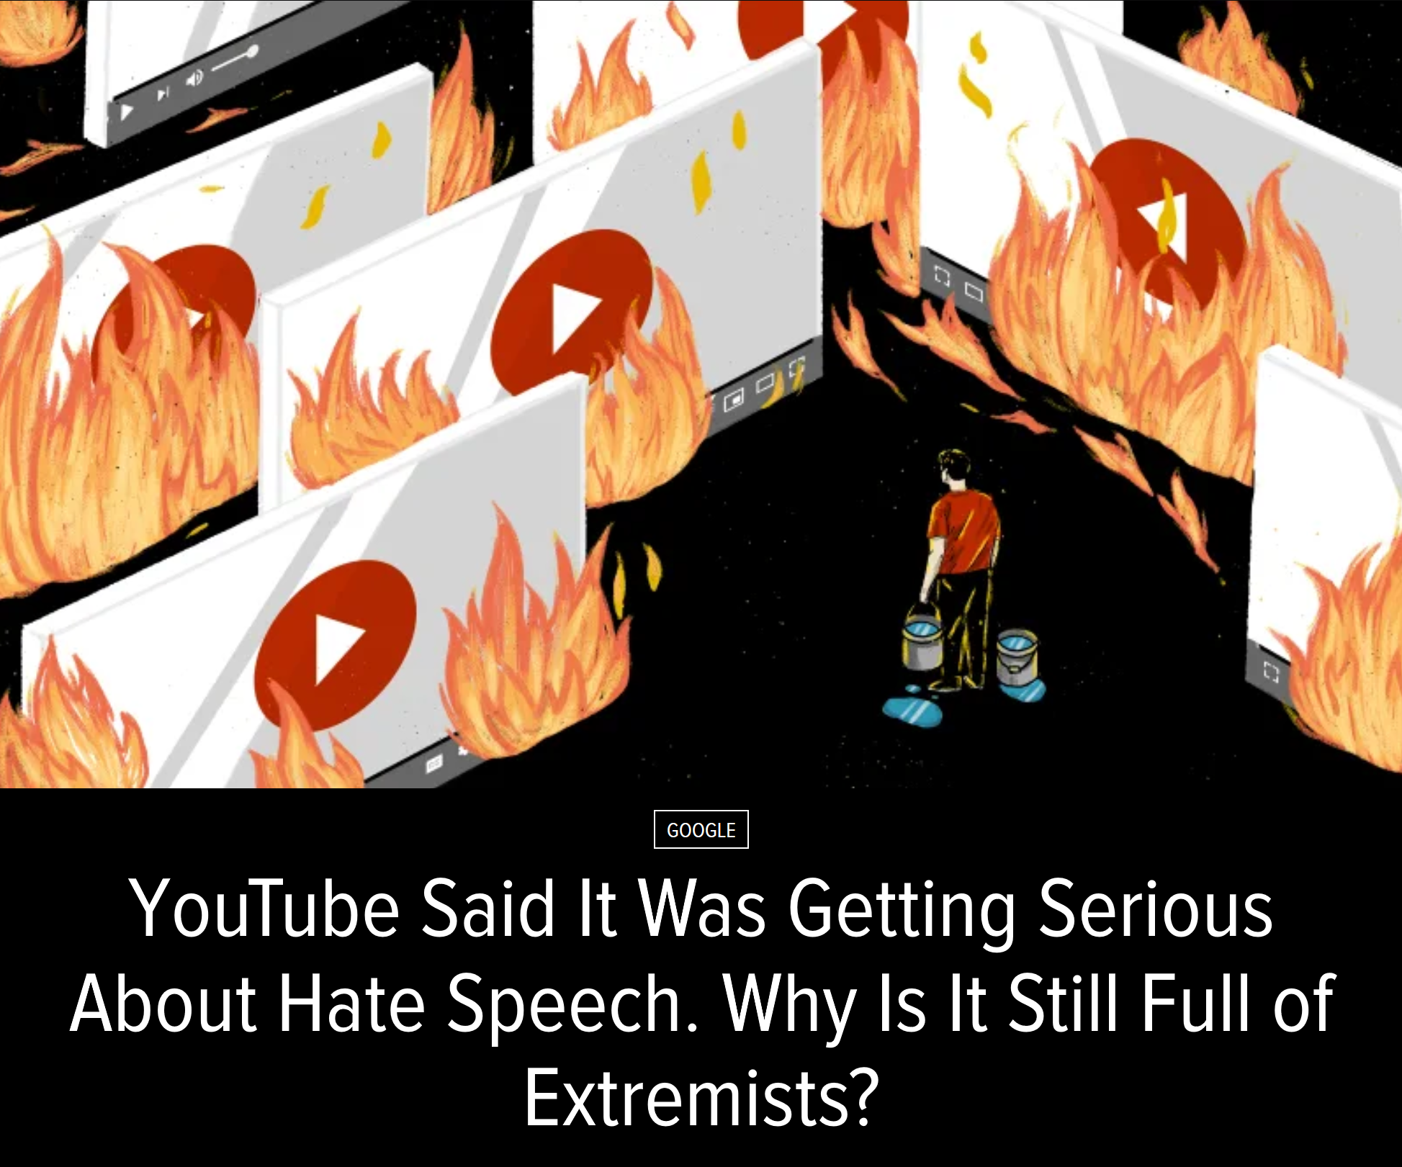
Motivating Example: Content Moderation
Platforms take a “neutral” approach to moderating speech
First amendment
CDA 230
Real world consequences
Violent radicalization
Genocide in Myanmar
Notes:
Problem to be solved.
A point to make here is that there is an ethical choice about what problem to take up. Already, ethics has entered in the determination that this is a social and ethical problem to be solved. The project itself is value laden.
Another point to make here is that the constraints on what solutions are acceptable are not only technical, but ethical. The solution has to be consistent with rights to expression and free speech for examples.
So the takeaway for students is that they are involved in ethics – value-based decision-making - right from the beginning, and there is no getting away from it.

Slide 4
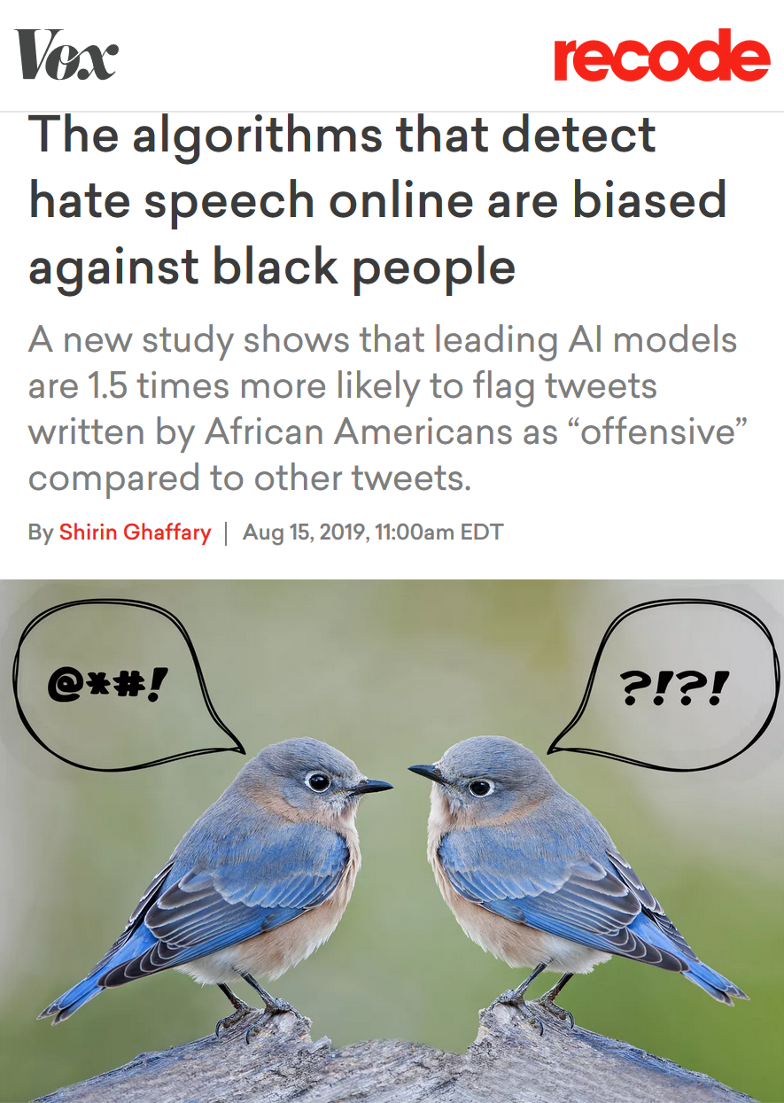
Bad Solutions
Idea: train a machine learning model to detect hate speech
Fast and scalable
“Fair” because it doesn’t rely on human judgement
Harms the people it was supposed to protect
Fails to take context into account
Historical quotations vs. expressions of opinion
Ownership of slurs by people from targeted groups
Notes:
What makes for a good/bad solution to the problem.
A good solution is not only a technically elegant or interesting one. How good a solution is can and should be evaluated on ethical as well as technical grounds.
In this case, the solution has problematic disparate impacts among groups and ethically problematic unintended consequences (or secondary effects)
This is also a good point at which to emphasize the importance of diverse perspectives and of trying to consider problems and solutions from other positions and perspectives than your own. Each of our own perspectives is highly limited and it’s a mistake to take it as universal or authorative – it leads to both ineffectual products and socially problematic ones

Slide 5
Content Moderation Done Right?
Defining hate speech
Examining socio-historical power relations between groups
Soliciting diverse perspectives on the problem and possible solutions
Taking context into account
Historical quotes, artistic expression, in-group vs. out-group speaker…
Implementing a process
Crowdsourced detection? Automation with AI? Paid content moderators?
Process for contesting decisions and requesting a review?
Deciding how to enforce the policy
Censor content and/or ban the speaker?
Flag content and show a warning label or collapse it (i.e. require a click to view)?
Taking the delivery medium into account
Should hate speech appear in search results?
Should hate speech be algorithmically promoted or recommended (e.g. in a news feed)?
Answering all of these questions require making challenging, normative choices!
Notes:
The point here is that if you want to solve the problem well, you need to take A LOT more into account in the design and implementation process than just the technical components.
Conceptual clarity and problem definition – e.g. defining hate speech
Social/historical context and non-standard cases – e.g. historical quotes, differential linguistic usage and speech patterns
Context of implementation – e.g. capacity, oversight
Main Takeaway: Good computer science solutions require thinking about the values involved, the social context into which the technology will be implemented, and the socio-technical system of implementation. And leveraging knowledge from other (non-technical areas) – such as social science and ethics.
The goal of this curriculum, and of VSD, is to help them to do that.

Slide 6
More examples
Ethically and morally implicated technology is everywhere!
Facial recognition
Smart speakers that secretly have humans transcribe the recordings
Ridesharing apps that congest streets; home sharing apps that displace residents
Third-party data collection for hyper-targeted advertising
Self driving cars, autonomous drones
AIs that gate access to loans, insurance, employment, government services…
Deceptive user interface “dark patterns”
And on… and on… and on…

Slide 7
Values and Technology
Technology is the result of human imagination
All technology involves design
All design involves choices among possible options
All choices reflects values
Therefore, all technologies reflect and affect human values
Ignoring values in the design process is irresponsible
Engaging with values in the design process offers creative opportunities for:
Technical innovation
Improving the human condition (doing good and saving the world)
Notes:
Point to make: Ethics here is not about not doing terrible things. The assumption is that you are not evil. It is about how to be successful at doing good things (e.g. preventing election manipulation, improving education outcomes), as well as avoiding doing things that appear fine but turn out to be problematic (e.g. that violate privacy or exacerbate injustices). It is not a something you have to worry about in addition to doing good CS or DM – it is part of what is involved in doing good CS and DM, from BOTH a product and a societal perspective

Slide 8
Value Sensitive Design (VSD)
The goal of Value Sensitive Design is to make socially-informed and thoughtful value-based choices in the technology design process
Appreciating that technology design is a value-laden practice
Recognizing the value-relevant choice points in the design process
Identifying and analyzing the values at issue in particular design choices
Reflecting on those values and how they can or should inform technology design

Slide 9
VSD in Brief
VSD is a…
VSD is not…
Outlook for seeing the values in technology design
Process for making value-based choices within design
Combines empirical, value, and technical investigations
Design solutions that incorporate the values held by stakeholders
Considers problems and solutions from diverse perspectives
A moral framework or system of ethics
It does not tell you what decisions to make
Rather, it incorporates value reflections into the choosing process
It does not provide an algorithm for making decisions
No easy answers
Takes sustained commitment

Slide 10
Modes of Inquiry
Empirical Investigation
How do stakeholders prioritize competing values?
Differences between what people say and what people do?
Economic incentives?
What are the benefits/costs and their distributions?
Value Investigation
What is the overall goal of the technology?
What is the social context in which the technology will be situated?
What values are at stake?
Which stakeholders are legitimately impacted?
What value-oriented criteria will be used to gauge project success?
Technical Investigation
What frameworks and tools enable designers to meet value-oriented goals?
Impact of law, policy, and regulation on your design?
What about cybersecurity?
Do quantifiable objectives align with value-oriented criteria?

Slide 11
Expertise in Inquiry
Empirical Investigation
Where?
In the field, gathering knowledge about the world
Disciplinary skills
Sociology
Behavioral economics
Experimental psychology
Political science
Value Investigation
Where?
In front of a whiteboard
Disciplinary skills
Applied ethics
Critical race and gender theory
Law and policy
Environmental analysis
Technical Investigation
Where?
In the computer, analyzing data and prototyping
Disciplinary skills
Computer science
Data science
Cybersecurity/privacy

Slide 12
Tools of Inquiry
Empirical Investigation
Observational studies
Surveys
Semi-structured interviews
Experimental manipulations (A/B testing)
Collection of primary source documents
Value Investigation
Discussion and iteration with a multi-disciplinary team
Contextualization of empirical results
Case studies
Technical Investigation
User-centered investigation of prototypes
Auditing data and algorithms for bias
Red team cybersecurity audits
Privacy impact assessments

Slide 13
VSD in Action
Framing Technical Work
Clarify explicitly supported project values and designer stance
Situate the work within a social context
Empirical Investigation
Identify key direct and indirect stakeholders
Elicit potential values from stakeholders
Systematically identify benefits and harms for stakeholders
Refine the social context
Conceptual Investigation
Develop working definitions of key values and identify potential value tensions
Define technical and technological success objectives
Map tensions to success objectives
Technical Investigation
Identify choice points where the design team has the mandate, control, or power to intervene
Build technological and social interventions
Monitor and Respond to Change Over Time
Notes:
Path may not be entirely linear in practice. Conceptual investigation may identify new stakeholders, contexts, benefits, or harms that require further empirical investigation. Similarly, Technical Investigations should be tested in the field before deployment, which also involves empirical investigation.

Slide 14
Challenges
Building ethical technology is not easy. That doesn’t mean we can ignore the challenges!
Define success objectives?
Identify the social structure in which a technology is situated?
Identify legitimate direct and indirect stakeholders?
Elicit the full range of values at play?
Balance and address value tensions?
Identify and mitigate unintended consequences?
How to…

Slide 15
Defining Success
In CS, we typically think about technical success
Does the technology function?
Does it achieve first-order objectives?
Example metrics:
Test coverage and bug tracker
Crash reports
Benchmarks of speed, prediction accuracy, etc.
Counts of app installations, user clicks, pages viewed, interaction time, etc.
VSD asks that we think about technological success
Is the technology beneficial to stakeholders, society, the environment, etc.?
Is the technology fair or just?
Example metrics:
Assessments of quality of life
Measures of bias
Reports of bullying, hate speech, etc.
Carbon footprint

Slide 16
Identifying Social Structures
All technology is socially situated. What is the social structure around your technology?
What are the benefits and costs of the technology?
How are the benefits and costs distributed across individuals and society?
Are there socio-economic or historical inequalities?
How could the technology change the activity into which it is introduced?
How will social structures change over time?
Answering these questions requires empirical inquiry!

Slide 17
Identifying Stakeholders
Whose values are impacted by a piece of technology?
Direct Stakeholders
Indirect Stakeholders
The sponsor (your employer, etc.)
Members of the design team
Demographically diverse users
Races and ethnicities, men and women, LGBTQIA, differently abled, US vs. non-US, …
Special populations
Children, the elderly, victims of intimate partner violence, families living in poverty, the incarcerated, indigenous peoples, the homeless, religious minorities, non-technology users, celebrities
Roles
Content creators, content consumers, power users, …
Bystanders
Those who are around your users
E.g. pedestrians near an autonomous car
“Human data points”
Those who are passively surveilled by your system
Civil society
E.g. people who aren’t on social media are still impacted by disinformation
People who care deeply about the issues or problem being addressed
Those without access
Barriers include: cost, education, availability of necessary hardware and/or infrastructure, institutional censorship…

Slide 18
Filtering Stakeholders
It is tempting to be overly comprehensive when enumerating stakeholders…
But not every impacted individual has legitimate values at play
Examples:
Foreign election meddlers are affected by content moderation, want to protect their “free speech”
Dictatorships are impacted by universal encryption, want unfettered surveillance capabilities
Cyber criminals want to steal things, are against cybersecurity measures
These stakeholders are not legitimate, may be safely ignored
Notes:
The takeaway here is that if the goals of the stakeholder are illegal or unethical, they do not merit consideration.

Slide 19
Identifying the Full Range of Values
What values are relevant to different, legitimate stakeholders?
Some values are universal: accessibility, justice, human rights, privacy
Others are tied to specific stakeholders and social contexts
Identifying implicated values
Grounded in a thorough conceptual and empirical understanding of the relevant features of the social situation
Informed by experience/knowledge from similar technologies or design decisions (case studies, etc.)
Refined through empirical investigation
Reflect on the scale of impacts to various stakeholders – focus on the major challenges

Slide 20
Example Values
Human welfare refers to people’s physical, material, and psychological well-being
Accessibility refers to making all people successful users of information technology
Respect refers to treating people with politeness and consideration
Calmness refers to a peaceful and composed psychological state
Freedom from bias refers to systematic unfairness perpetrated on individuals or groups, including pre-existing social bias, technical bias, and emergent social bias

Slide 21
Example Values
Ownership and property refers to a right to possess an object (or information), use it, manage it, derive income from it, and bequeath it
Privacy refers to a claim, an entitlement, or a right of an individual to determine what information about himself or herself can be communicated to others
Trust refers to expectations that exist between people who can experience good will, extend good will toward others, feel vulnerable, and experience betrayal
Accountability refers to the properties that ensures that the actions of a person, people, or institution may be traced uniquely to the person, people, or institution

Slide 22
Example Values
Autonomy refers to people’s ability to decide, plan, and act in ways that they believe will help them to achieve their goals
Informed consent refers to garnering people’s agreement, encompassing criteria of disclosure, comprehension, voluntariness, competence, and agreement
Identity refers to people’s understanding of who they are over time, embracing both continuity and discontinuity over time
Environmental sustainability refers to sustaining ecosystems such that they meet the needs of the present

Slide 23
Addressing Value Tensions
Stakeholders
Values
Value Tensions
Design Trade-offs
The most challenging step in VSD, by far
This is where the hard choices happen
What are the core values that cannot be violated?
Which tensions can be addressed through:
Technological mechanisms?
Social mechanisms?
When a tension cannot be reconciled, whose values take precedence?
What tensions must be addressed immediately, versus later on through additional features?
Early design decisions will unavoidably foreclose future design possibilities

Slide 24
Example: Content Moderation
The issue: free expression in tension with welfare and respect
Some speech may be hurtful and/or violent
Removing this speech may be characterized as censorship
Bad take: unyielding commitment to free speech, no moderation
Trolls and extremists overrun the service, it becomes toxic, all other users leave
Violent speech actually impedes free speech in general
Bad take: strict whitelists of acceptable speech
Precludes heated debate, discussion of “sensitive topics”
Disproportionately impacts already marginalized groups
Good take: recognizing that moderation will never be perfect, there will be mistakes and grey areas
Doing nothing is not a viable option
Clear guidelines that are earnestly enforced create a culture of accountability

Slide 25
Example: “Going DARK”
The issue: rule of law in tension with security and privacy
Law enforcement wants access to data so they can identify and prosecute crimes
End-to-end encryption prevents many avenues of data access for law enforcement
But, encryption also preserves people’s digital privacy
Bad take: valuing rule of law above all else
Requiring encryption back doors does give law enforcement access…
But, back doors allow malicious parties to compromise encryption as well
Good take: framing the debate in terms of costs
Individuals and companies rely on encryption to secure data, untold trillions of $ at stake
Law enforcement’s interests are legitimate, but crime is relatively rare
Bonus: law enforcement has other tools to access data besides cracking encryption

Slide 26
Tips for Addressing Value Tensions
Identify Red Lines
Red lines: bedrock values that cannot be violated
Address these first
Look for Win—Wins
Look for win—win scenarios
Some stakeholders may be agreement; others may want the same outcome but for different reasons
Embrace Tradeoffs
Be open and honest when value tradeoffs are necessary
E.g. when functionality and privacy are in tension, both can be addressed through informed consent
Don’t Forget Social Solutions
Creatively leverage technical and social solutions in concert
E.g. if a new system is going to automate away jobs, pair it with a retraining program

Slide 27
Identifying Unintended Consequences
Technology will be adopted in unanticipated ways. Being intellectually rigorous means considering and mitigating risks in designs ahead of time.
Our recommendation system promotes misinformation or hate speech?
Failure to consider incentive alignment
Our database is breached and publicly released?
Failure to consider security and privacy
Our facial recognition AI is used to identify and harass peaceful protestors?
Our child safety app is used to stalk women?
Failure to consider appropriation across contexts and dual uses of technology
Our chatbot is sexist or racist?
Failure to consider biases in data
What if…
Notes:
Hard to not do evil when you’re building powerful tools.

Slide 28
VSD in Action
Framing Technical Work
Clarify explicitly supported project values and designer stance
Situate the work within a social context
Empirical Investigation
Identify key direct and indirect stakeholders
Elicit potential values from stakeholders
Systematically identify benefits and harms for stakeholders
Refine the social context
Conceptual Investigation
Develop working definitions of key values and identify potential value tensions
Define technical and technological success objectives
Map tensions to success objectives
Technical Investigation
Identify choice points where the design team has the mandate, control, or power to intervene
Build technological and social interventions
Monitor and Respond to Change Over Time

Slide 29
Practical Tips
Adopt, Extend, Adapt
Adopt and extend the methods for your own purposes. Adapt for your sociotechnical setting.
Variety
Use a variety of empirical values-elicitation methods, rather than relying on a single one.
Continuous Evaluation
Continue to elicit stakeholder values throughout the design. If new values of import surface during the design process, engage them.
Anticipation
Anticipate unanticipated consequences: continue the VSD process throughout the deployment of the technology
Collaborate
Particularly with people from other disciplines, and those with deep contextual knowledge of and expertise in your sociotechnical setting.

Slide 30
VSD Is Not An Algorithm
We’ve provided example VSD questions and steps to help clarify your thinking
But, fundamentally VSD is an outlook and a process
VSD is not an algorithm
There is no design recipe for VSD
There is no way to #include vsd.h or import VSD
Committing to VSD means being thoughtful and agile
No single right answer to complex ethical and moral questions…
But there are lots of wrong answers
Engaging with values in the design process offers creative opportunities for:
Technical innovation
Improving the human condition (doing good and saving the world)

Slide 31
Go forth and build responsibly
Questions? Contact Professor Christo Wilson (c.wilson@northeastern.edu)
Khoury College of Computer Sciences, Northeastern University

Slide 32
Sources
Value Sensitive Design: Shaping Technology with Moral Imagination (The MIT Press). Batya Friedman and David G. Hendry, 2019. https://www.amazon.com/Value-Sensitive-Design-Technology-Imagination/dp/0262039532/
The algorithms that detect hate speech online are biased against black people (Recode). Shirin Ghaffary, 2019. https://www.vox.com/recode/2019/8/15/20806384/social-media-hate-speech-bias-black-african-american-facebook-twitter
YouTube Said It Was Getting Serious About Hate Speech. Why Is It Still Full of Extremists? (Gizmodo). Aaron Sankin, 2019. https://gizmodo.com/youtube-said-it-was-getting-serious-about-hate-speech-1836596239

